Slide 1

CREDIT CARD FRAUD DETECTIONUSING MACHINE LEARNING
MENTOR: MS.G.SARANYA
Presented by:
SHASWATHA THILAKA .D -19EUEC135

Slide 2
credit card frauds in India
A typical organization loses 5% of their revenue to fraud.
2480 cases of fraud in 18 public sector banks involving Rs.31,898,63 crore: RTI
In 2017-2018,total of 911 credit card frauds amounting Rs.65.26 crore: RBI

Slide 3
OBJECTIVE
The Credit Card Fraud Detection Problem includes modelling past credit card transactions with the data of the ones that turned out to be fraud.
This model recognizes whether a new transaction is fraudulent or not.
It detects >99% of the fraudulent transactions while minimizing the incorrect fraud classifications.

Slide 4
SCOPE
This system can be used by
Retailers
Payment service providers
Financial institutions.

Slide 5
LITERATURE SURVEY
Anuruddha Thennakoon, Chee Bhagyani, Sasitha Premadasa, Shalitha Mihiranga, Nuwan Kuruwitaarachchi “Real-time Credit Card Fraud Detection Using Machine Learning” – 2019
- use of predictive analytics done by the implemented machine learning models and an API module to decide if a particular transaction is genuine or fraudulent.
P. Jayant , Vaishali , D. Sharma Amity Institute of Information Technology Amity University, U.P “Survey on Credit Card Fraud Detection Techniques”
- the fraudulent transactions are those specifically identified by the institutional auditors as those that caused an unlawful transfer of funds from the bank sponsoring the credit cards.

Slide 6
Literature survey
SamanehSorournejad , Zahra Zojaji , Reza Ebrahimi Atani , Amir Hassan Monadjemi Department of Information Technology, University of Guilan, Iran “A Survey of Credit Card Fraud Detection Techniques”
-some current fraud detection techniques which are applied to credit card fraud detection tasks, also main advantage and disadvantage of each approachwill be discussed
Sonal Mehndiratta , Mr. Kamal Gupta Hod and Assistant professor Guru Nanak Institute of Technology Mullana, Ambala “Credit Card Fraud Detection Techniques”
-The fraud transaction prediction has the two phases which are feature extraction and classification.

Slide 7
NOVELTY
Aim to provide customer identification for retailers, payment service providers, and financial institutions.
This solution also allows for creating a detailed risk profile for every customer.

Slide 8
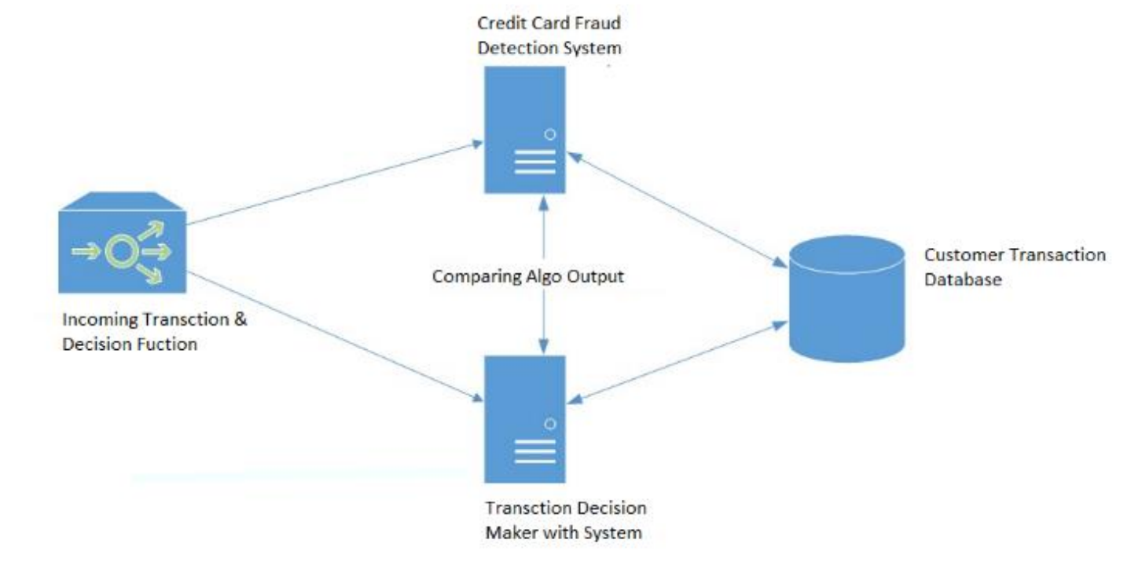
BLOCK DIAGRAM

Slide 9
ADVANTAGES
Higher accuracy of fraud detection
Less manual work needed for additional verification
Fewer false declines
Ability to identify new patterns and adapt to changes

Slide 10
RESULT
The code prints out the number of false positives it detected and compares it with the actual values. This is used to calculate the accuracy score and precision of the algorithms. The fraction of data we used for faster testing is 10% of the entire dataset. The complete dataset is also used at the end and both the results are printed.
These results along with the classification report for each algorithm is given in the output as follows, where class 0 means the transaction was determined to be valid and 1 means it was determined as a fraud transaction.

Slide 11
CONCLUSION
High percentage of accuracy is to be expected due to the huge imbalance between the number of valid and number of genuine transactions. Since the entire dataset consists of only two days’ transaction records, its only a fraction of data that can be made available if this project were to be used on a commercial scale. Being based on machine learning algorithms, the program will only increase its efficiency over time as more data is put into it.

